Slide 1
Guidelines
Kindly use the given template for submitting your prototype(Make a copy of the template)
One team is only required to submit one project.
Follow this template while preparing your presentation.
You are welcome to add as many POCs and design concepts to support your project.
The project should be feasible and the team members should be capable enough, to come up with the fully functioning prototype of the same idea, if required.
In case of queries, kindly reach out to us at solutionchallengesupport@hack2skill.com
Note: Prototype must include cloud deployment and use at least one Google AI model or service (e.g., Gemini) as part of the solution.

Slide 2


Team Details
Team name: AI Autolyte
Team leader name: kaushtuv parashar
Problem Statement: service Fragmentation

Slide 3
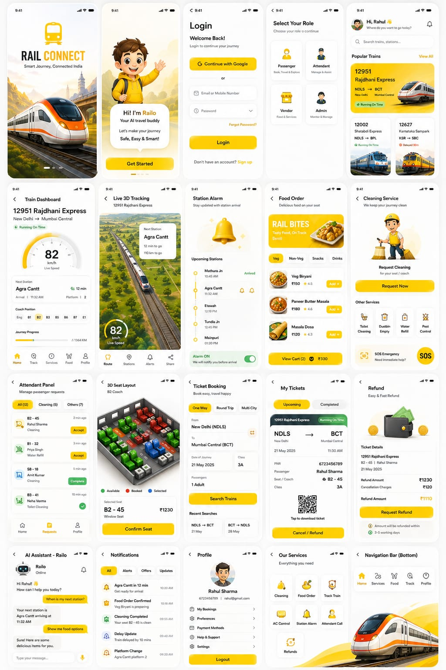
Brief about your solution
Our solution is a smart railway management and passenger experience platform that combines:
Real-time train tracking
Digital ticket booking
Seat selection system
Onboard services (food, cleaning, SOS)
Intelligent dashboard
It provides a single unified platform for passengers to manage their entire journey—from booking to arrival—through a modern web application.

Slide 4
Opportunities
Growing demand for digital railway services
Lack of real-time transparency in train systems
Need for better passenger experience
Scope for AI-based recommendations
Integration with smart transportation systems
USP of the proposed solution
Real-time interactive dashboard
Smart user experience (UX-first design)
Live tracking + service integration
Modern, scalable architecture
All-in-one railway ecosystem

Slide 5
How different is it from any of the other existing ideas?
b. How will it be able to solve the problem?
❌ Confusing booking systems → ✅ Simple UI flow
❌ No real-time clarity → ✅ Live tracking + updates
❌ Multiple apps needed → ✅ All-in-one platform
❌ Poor passenger support → ✅ Integrated services
Existing Systems (IRCTC, NTES) | our Solution
Fragmented experience | Unified platform
Basic UI/UX | Modern dashboard UI
Limited real-time visuals | Live tracking + speed simulation
No service integration | Food, cleaning, SOS in one app
Complex booking flow | Simplified, user-friendly flow

Slide 6
List of features offered by the solution
Core Features:
Train search & booking
Seat selection (interactive)
Passenger management
Payment integration
Advanced Features:
Live train tracking
Speed monitoring
Journey timeline
Platform & station info
Services:
Food ordering
Cleaning request
Emergency SOS

Slide 7
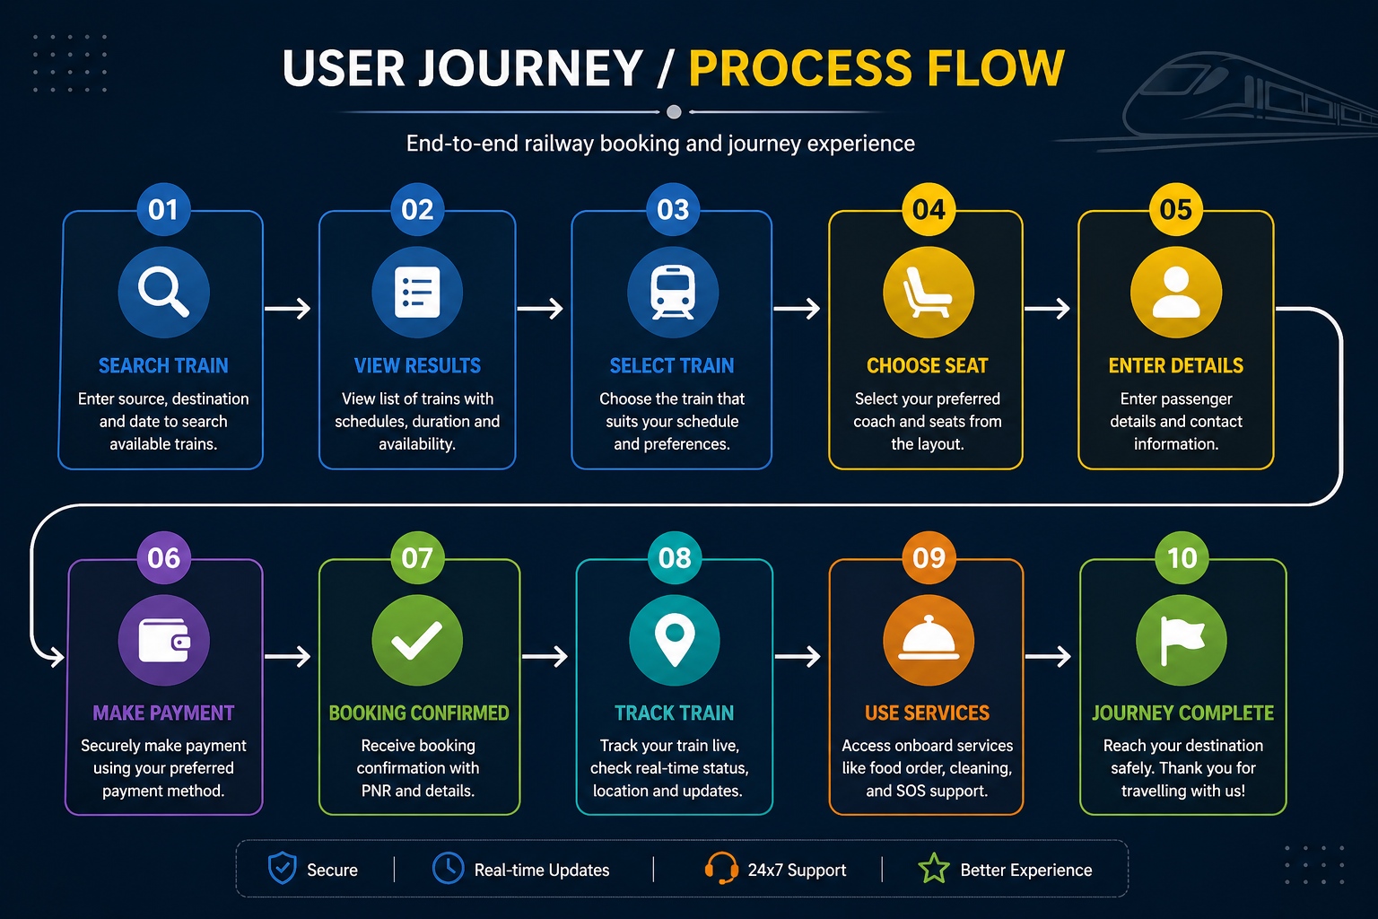
Process flow diagram or Use-case diagram

Slide 8
Wireframes/Mock diagrams of the proposed solution (optional)

Slide 9
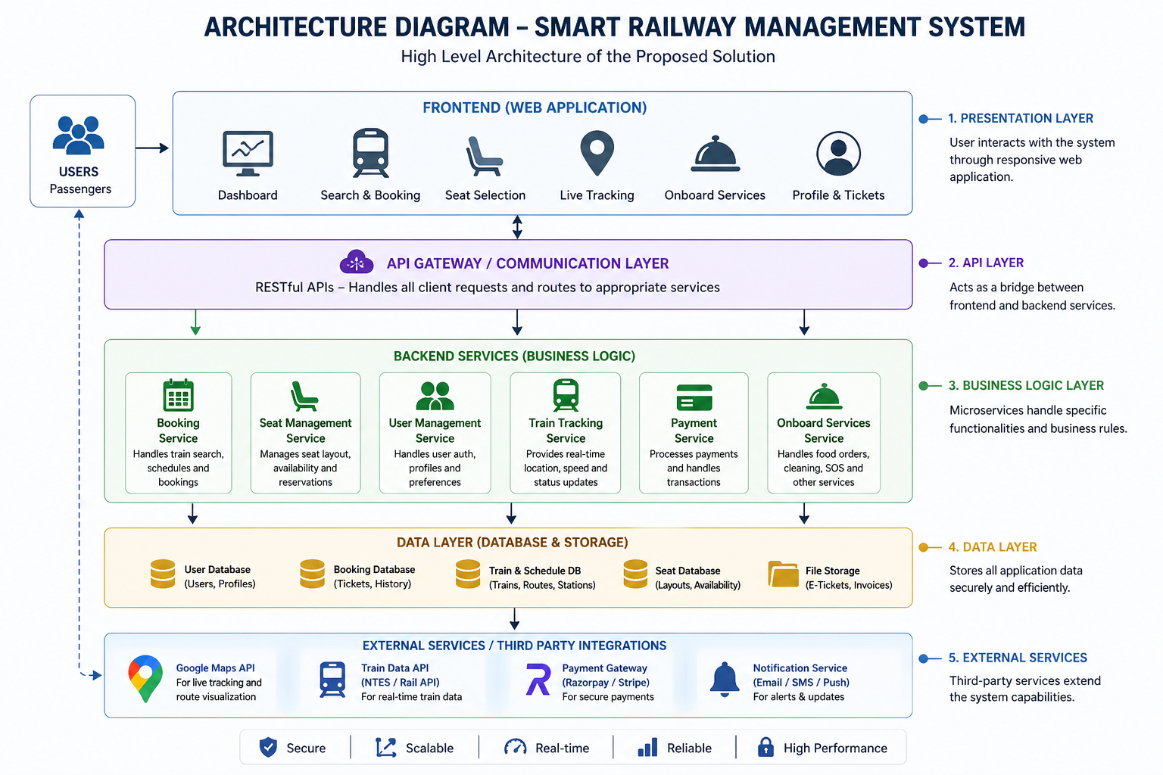
Architecture diagram of the proposed solution

Slide 10
Technologies to be used in the solution
Frontend:
React.js
Tailwind CSS
JavaScript
Backend (optional):
Node.js / Express
Firebase
APIs:
Google Maps API
Payment Gateway API

Slide 11
Estimated implementation cost (optional)
Component | Cost
Development | ₹50,000 – ₹1,50,000
APIs (Maps, etc.) | ₹5,000 – ₹20,000/month
Hosting | ₹2,000/month
Maintenance | ₹10,000/month

Slide 12
Snapshots of the MVP

Slide 13
Additional Details/Future Development (if any)
AI-based train recommendations
Real-time GPS integration
Mobile app (Android/iOS)
E-ticket generation (PDF)
Predictive delay system
Multi-language support

Slide 14
Provide links to your:
GitHub Public Repository
Demo Video Link (3 Minutes)
MVP Link
Working Prototype Link

Slide 16


